Slide 1
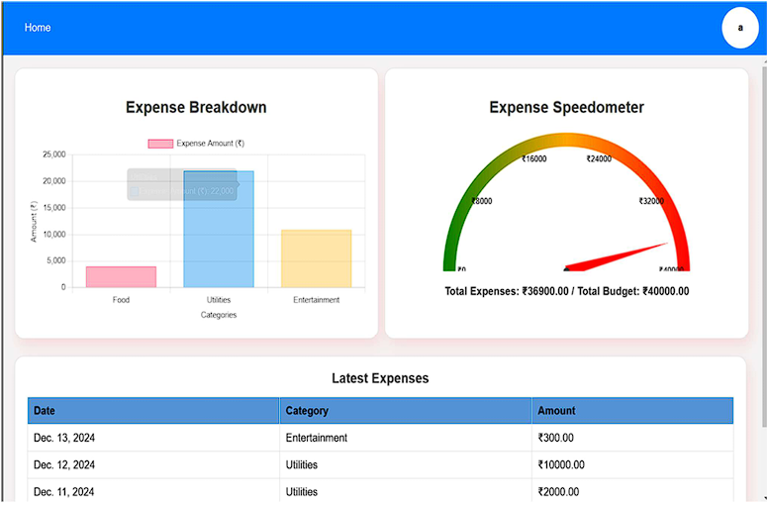

Financial Dashboard: Visualizing Your Finances
This presentation explores the development of a financial dashboard designed to provide users with a centralized view of their financial metrics.
by P V SHYAM SUNDAR LAL

Slide 2
Module 4: Dashboard and Data Visualization
Centralized View
Interactive Charts
Provides users with a centralized view of their financial metrics.
Includes interactive charts and graphs to visualize spending trends.

Slide 3

Key Features
1
Expense Breakdown Bar Plots
2
Expense Speedometer
A visual gauge that tracks spending against budget limits.
Visualize category-wise expenses using bar charts.
3
Latest Expenses
4
Budget Tracking
Displays a list of the most recent expenses.
Visual indicators highlight overspending when users exceed their set budget limits.

Slide 4
Expense Speedometer
Expense Under Budget
Expense Over Budget
Green zone indicates spending is within budget limits.
Red zone indicates spending has exceeded the budget limit.
Expense Approaching Limit
Yellow zone indicates spending is approaching the budget limit.

Slide 5
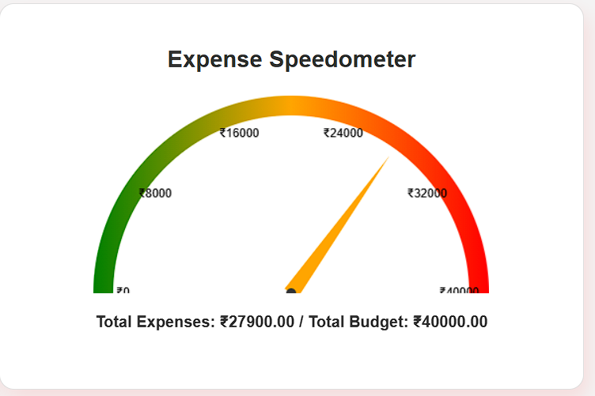
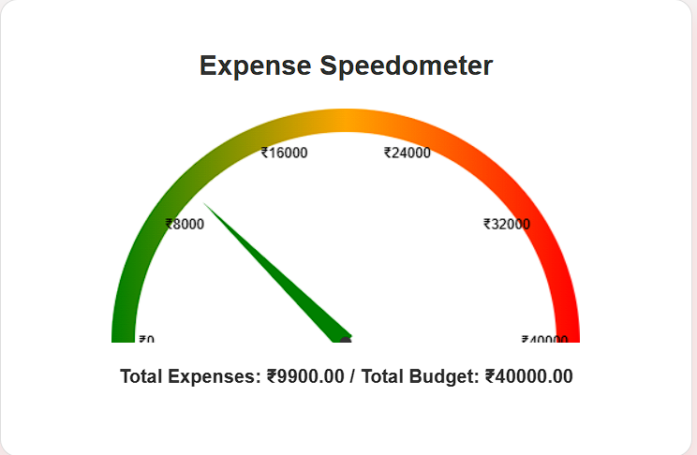
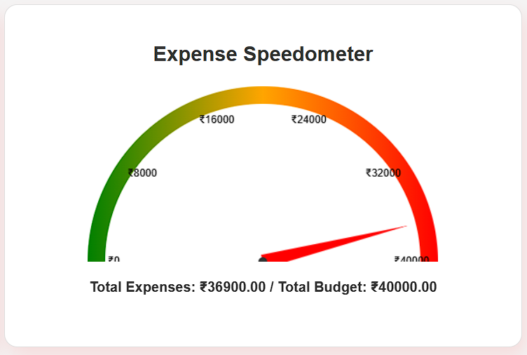
Expense under Warning limit of the Budget
Expense under the Budget
Expense under Alert limit of the Budget

Slide 6
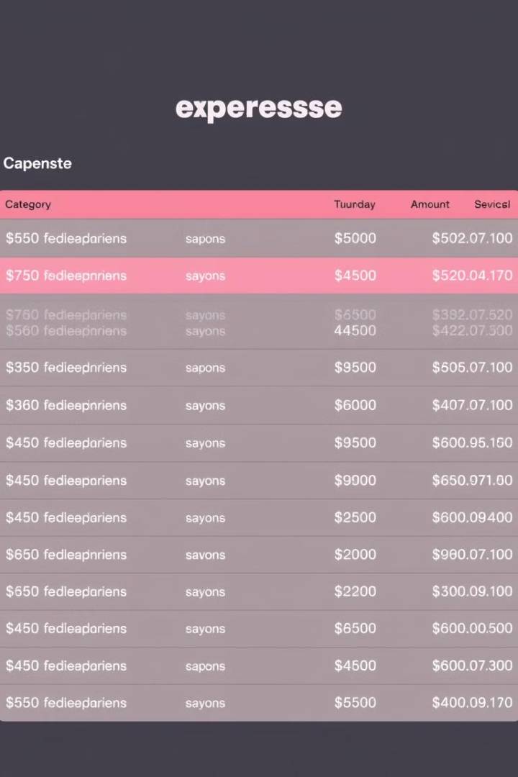
Latest Expenses
Date
Category
Amount
Dec. 13, 2024
Entertainment
₹300.00
Dec. 12, 2024
Utilities
₹10000.00
Dec. 11, 2024
Utilities
₹2000.00

Slide 7
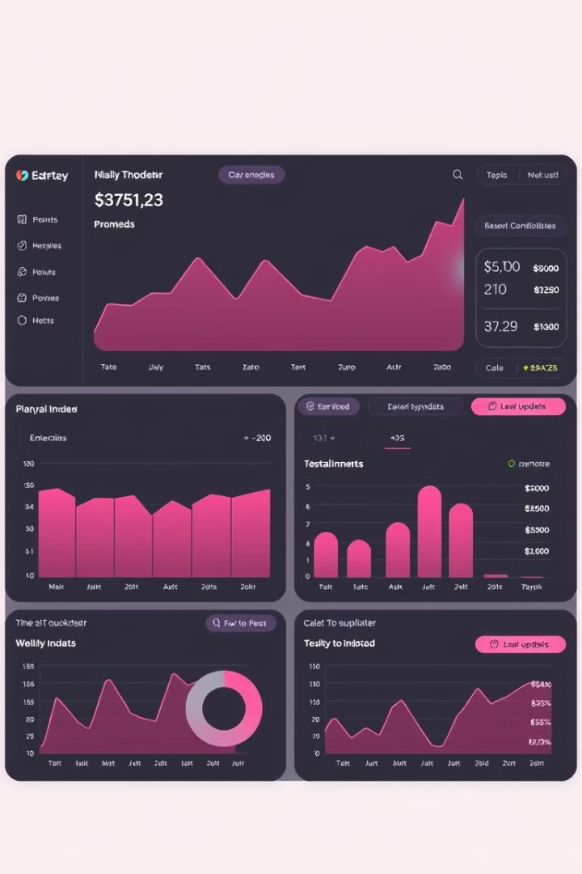
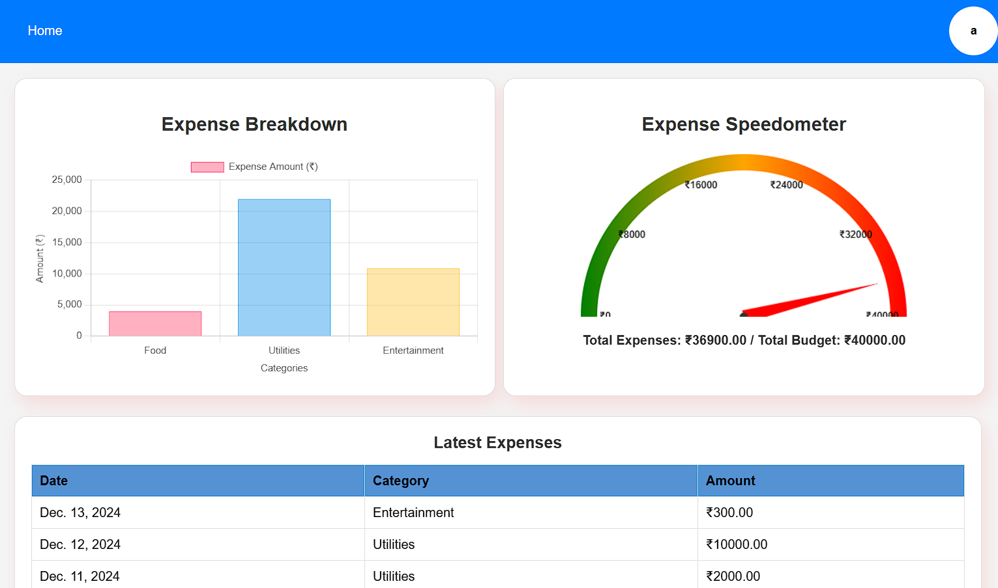
Real-Time Updates
The dashboard dynamically updates in real-time as new expenses are added, ensuring up-to-date financial insights.

Slide 8


